Slide 1
Longitudinal Motion 1
Eric Prebys, FNAL

Slide 2
Acceleration in Periodic Structures
We consider motion of particles either through a linear structure or in a circular ring
Always negative
In both cases, we can adjust the RF phases such that a particle of nominal energy arrives at the the same point in the cycle φ_{s}
Goes from negative to positive at transition

Slide 3
Slip Factors and Phase Stability
The sign of the slip factor determines the stable region on the RF curve.
η<0 (linacs and below transition)
η>0 (above transition)
“bunch”
Particles with lower E arrive earlier and see greater V.
Particles with lower E arrive later and see greater V.
Nominal Energy
Nominal Energy

Slide 4
Longitudinal Acceleration
Consider a particle circulating around a ring, which passes through a resonant accelerating structure each turn
The energy gain that a particle of the nominal energy experiences each turn is given by
Where the this phase will be the same for a particle on each turn
A particle with a different energy will have a different phase, which will evolve each turn as
Harmonic number (integer)
Period of nominal energy particle
Synchronous phase

Slide 5
Phase Stability
Thus the change in energy for this particle for this particle will evolve as
So we can write
Multiply both sides by and integrate over dn

Slide 6
Synchrotron motion and Synchrotron Tune
Going back to our original equation
For small oscillations,
And we have
This is the equation of a harmonic oscillator with
Angular frequency wrt turn (not time)
“synchrotron tune” = number of oscillations per turn (usually <<1)

Slide 7
Longitudinal Emittance
We want to write things in terms of time and energy. We have can write the longitudinal equations of motion as
We can write our general equation of motion for out of time particles as

Slide 8
So we can write
We see that this is the same form as our equation for longitudinal motion with α=0, so we immediately write
Where

Slide 9
We can define an invariant of the motion as
What about the behavior of Δt and ΔE separately?
Note that for linacs or well-below transition
Area=πε_{L}
units generally eV-s

Slide 10
Large Amplitude Oscillations
We can express period of off-energy particles as
So
Use:

Slide 11
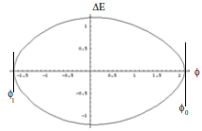
Continuing
Integrate
The curve will cross the φ axis when ΔE=0, which happens at two points defined by
Phase trajectories are possible up to a maximum value of φ₀. Consider .
Limit is at maximum of
unbound
bound

Slide 12
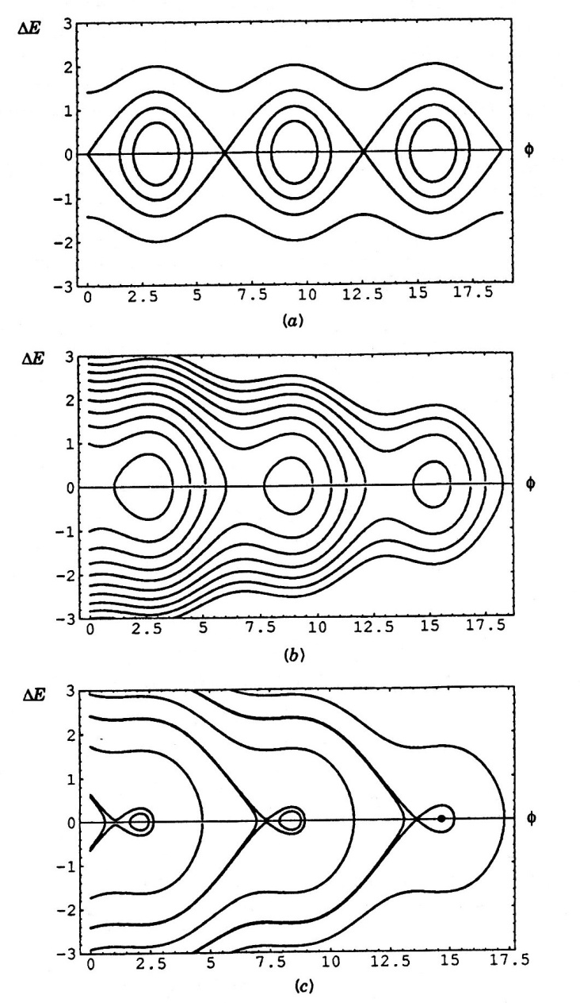
Longitudinal Separatrix
The other bound of motion can be found by
The limiting boundary (separatrix) is defined by
The maximum energy of the “bucket” can be found by setting φ=φ_{s}

Slide 13
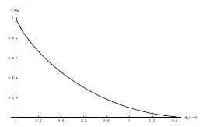
Bucket Area
The bucket area can be found by integrating over the area inside the separatrix (which I won’t do)

Slide 14
Transition Crossing
We learned that for a simple FODO lattice so electron machines are always above transition.
Proton machines are often designed to accelerate through transition.
As we go through transition
Recall so these both go to zero at transition.
To keep motion stable
At transition:

Slide 15
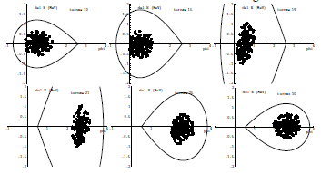
Effects at Transition
As the beam goes through transition, the stable phase must change
Problems at transition (pretty thorough treatment in S&E 2.2.3)
Beam loss at high dispersion points
Emittance growth due to non-linear effects
Increased sensitivity to instablities
Complicated RF manipulations near transition
Much harder before digital electronics

Slide 16
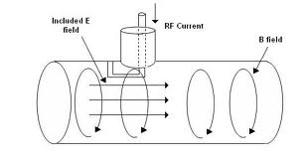
Accelerating Structures
The basic resonant structure is the “pillbox”
Maxwell’s Equations Become:
Boundary Conditions:
Differentiating the first by δt and the second by δr:

Slide 17
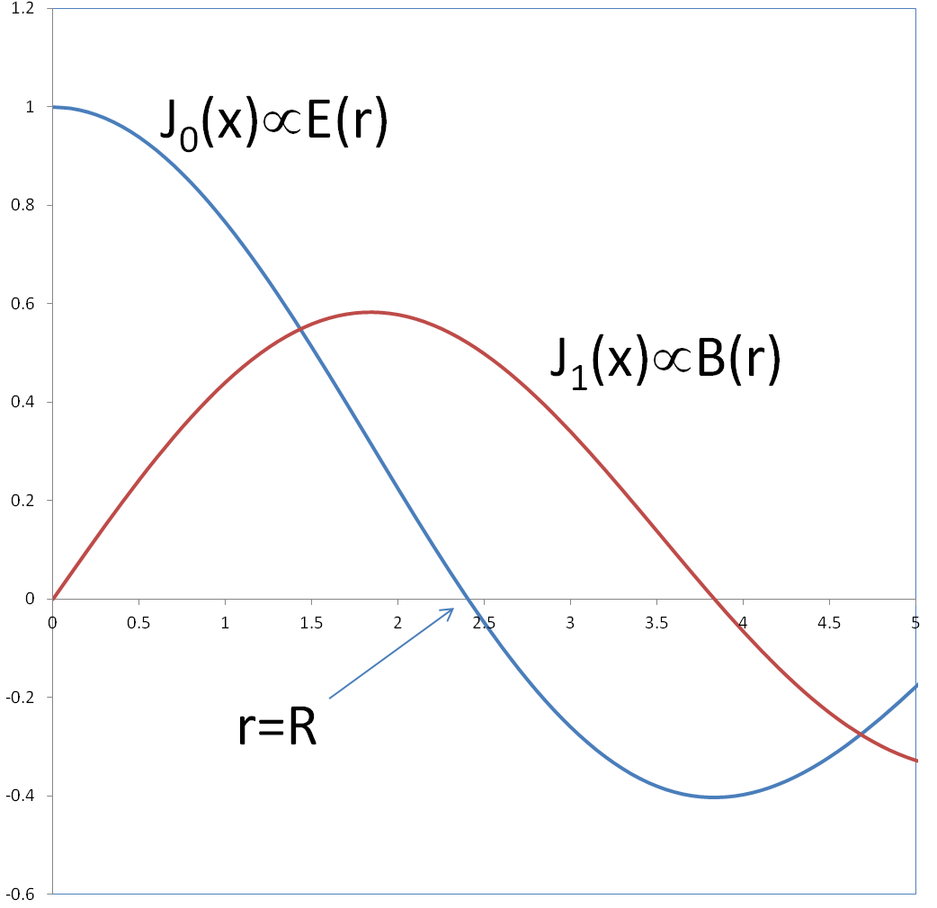
General solution of the form
Which gives us the equation
0th order Bessel’s Equation
0th order Bessel function
First zero at J(2.405), so lowest mode

Slide 18
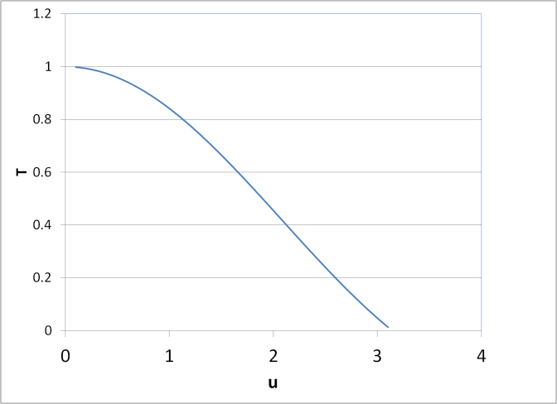
Transit Factor
In the lowest pillbox mode, the field is uniform along the length (v_{p}=∞), so it will be changing with time as the particle is transiting, thus a very long pillbox would have no net acceleration at all. We calculate a “transit factor”
Assume peak in middle
Example:
5 MeV Protons (v~.1c)
f=200MHz
T=85%➔u~1
Sounds kind of short, but is that an issue?

Slide 19
Power dissipation in RF Cavities
Volume=LπR²
Energy stored in cavity
Power loss:
=(.52)²~25%
Magnetic field at boundary
Surface current density J [A/m]
…………………….
B
Cylinder surface
2 ends
Average power loss per unit area is
Average over cycle

Slide 20
The figure of merit for cavities is the Q, where
So Q not very good for short, fat cavities!

Slide 21
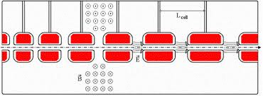
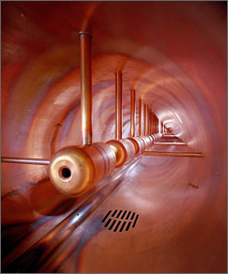
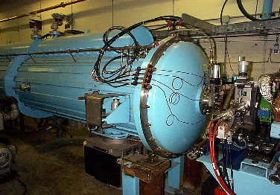
Drift Tube (Alvarez) Cavity
Put conducting tubes in a larger pillbox, such that inside the tubes E=0
Bunch of pillboxes
Gap spacing changes as velocity increases
Drift tubes contain quadrupoles to keep beam focused
➔
Fermilab low energy linac
Inside

Slide 22
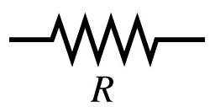
Shunt Impedance
If we think of a cavity as resistor in an electric circuit, then
By analogy, we define the “shunt impedance” for a cavity as
We want R_{s} to be as large as possible

Slide 23
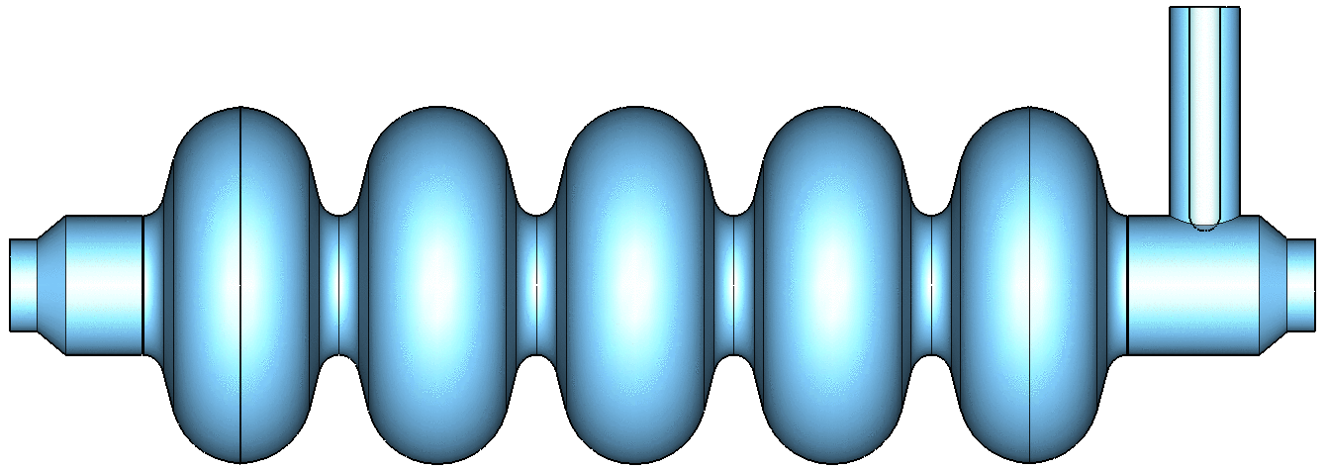
Other Types of Accelerating Structures
π cavities

Slide 24
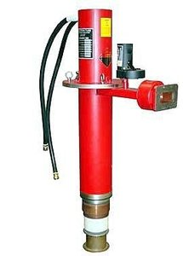
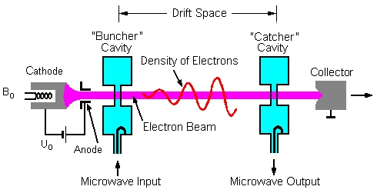
Sources of RF Power
For frequencies above ~300 MHz, the most common power source is the “klystron”, which is actually a little accelerator itself
Electrons are bunched and accelerated, then their kinetic energy is extracted as microwave power.

Slide 25
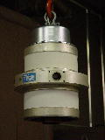
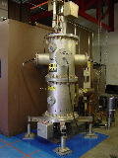
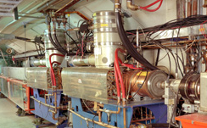
Sources of RF Power (cont’d)
For lower frequencies (<300 MHz), the only sources significant power are triode tubes, which haven’t changed much in decades.
53 MHz Power Amplifier for Booster RF cavity
FNAL linac 200 MHz Power Amplifier

